Slide 1

CMP1101: SEMICONDUCTORS

Slide 2
A little housekeeping
Office No:
Room 3014, New CEDAT Building
Class email:
CMP1101.ELECTRONICS1@GMAIL.COM
Office hours:
Wednesdays, Thursdays and Fridays: 2:00pm – 4:00pm

Slide 3
Referencing . . . . . when writing
Africa is a continent
The sun rises in the east
Ohm’s law:
“Engineering is the purposeful use of science” - - - - - Steve Senturia

Slide 4
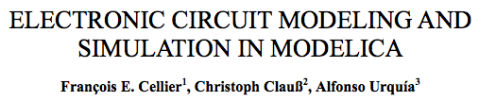
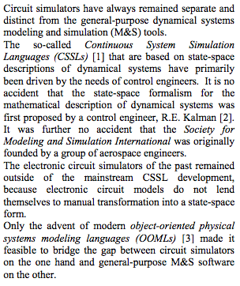
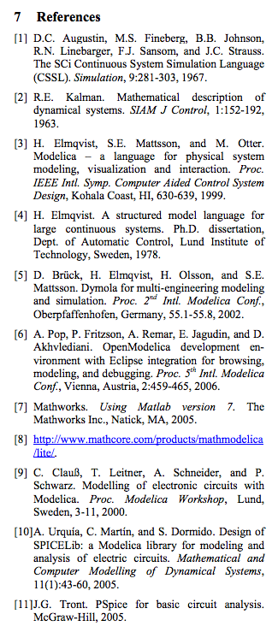
Plagiarism
You plagiarize if you don’t correctly give credit to statements/work by others.
e.g:
Circuit simulators have always remained separate and distinct from the general-purpose dynamical systems.
Instead:
use quotations, even for paraphrased statements.
reference the authors – by name or bibliography ordering.
“Circuit simulators have always remained separate and distinct from the general-purpose dynamical systems.”

Slide 5
Matter
Physical substance, occupies space and possesses rest mass.
Consists of atoms = electrons + nucleus (protons and neutrons)
Electrons have a negative charge
Protons have a positive charge = negative charge on the electrons
Neutrons have no charge
Each element is characterized by it’s number of electrons, referred to as the atomic number.
Electrons are spread around the nucleus in shells
Electrons can be easily stripped off the atom, leaving it positively charged.

Slide 6
Conduction in Materials
Conduction is the flow of current through a material.
Current flows as a result of charged pieces called carriers.
In electrolytes and gases: conduction is through the motion of ions
In metallic conductors: conduction is by the motion of electrons.
In insulators: no conduction
The number of free carriers in materials varies widely
The conductivity of various materials is thus very different.

Slide 7
Conduction in Materials
Conduction in elements is determined by the number of electrons in the valence orbit.
Some conductor atoms only have 1 valence electron in the outer orbit.
The slightest voltage causes free (dislodged) electrons to flow from one atom to another.
The density of free carriers in metals and insulators are approximately constant and cannot be changed over a given range.
The electrical resistance of a metal changes slightly with temperature.

Slide 8
Semiconductors
Semiconductors are either conductors or insulators.
Commonly used semiconductor elements:
Silicon: most popular – has 14 electrons, 4 in the valence orbit
A silicon atom in a crystal has 8 electrons in the valence orbit and 4 neighbor atoms.
A crystal is a special shape formed when each atom is normally bonded with it’s nearest neighbor atoms.
Germanium: 32 electrons, 4 in the valence orbit
Gallium arsenide

Slide 9
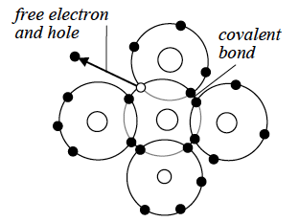
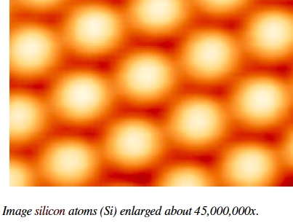
Silicon
Silicon Crystal

Slide 10
Conduction in Semiconductors
Conduction in semiconductors is defined by the density of free carriers.
It’s an intermediate between that of insulators and conductors.
In contrast with insulators and conductors, the density of free carriers in semiconductors can be changed by many orders.
This is what makes semiconductors special!
Conduction in semiconductors is facilitated by the movement of electrons
Just like in metals
Unlike in metals, the resistance of semiconductors grows with falling temperatures.
Resistance of a semiconductor material is called the bulk resistance.

Slide 11
Conduction in Semiconductors
Since bulk resistance falls with increasing temperature
It is thus a negative resistance
Semiconductors are thus negative temperature coefficient devices.
At absolute zero – a semiconductor is an insulator
At very high temperatures – a semiconductor is a conductor
At room temperature – a silicon crystal has only a few thermally produced free electrons.
Any temperature rise will result in thermal motion of atoms, a process referred to as thermal ionization.
The higher the ambient temperature, the easier it is to dislodge an electron from the valence orbit.

Slide 12
Electrons, Holes and Recombination
A hole is a vacant spot in the valence orbit caused by the departure of an electron.
The hole acts as a positive charge since it will attract and capture any electron in it’s immediate vicinity.
Occasionally, an electron will approach a hole, feel it’s attraction and fall into it.
Recombination: is the merging of a free electron and a hole.
In this way, valence electrons travel through a material.
Lifetime: is the average amount of time between the creation and recombination of a free electron and a hole.

Slide 13
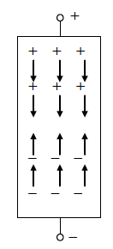
Electrons, Holes and Recombination
An applied voltage forces the free electrons and holes to flow between the -ve and +ve terminals of a crystal.
When the external voltage is applied across a semiconductor, the free electrons flow towards the +ve terminal while the reverse is true for holes.
The current in a semiconductor is thus the combined effect of the two kinds of flows.
Thus free electrons and holes carry a charge from one place to another.
Semiconductors thus have two carriers, as contrasted with metals that only have electrons for carriers.

Slide 14
Intrinsic and extrinsic Semiconductors
Intrinsic semiconductor: material whose conductivity increases strongly with increasing temperatures.
This property is characteristic of the pure material itself, thus the name intrinsic
Other factors such as heat and light also greatly influence the conductivity of intrinsic semiconductors.
Doping: the addition of impurity atoms to a pure tetravalent (intrinsic) crystal.
This raises the conductivity of semiconductor materials
Extrinsic semiconductor: A material that has been doped.
Impurity atoms added to an intrinsic semiconductor material change the thermal equilibrium density of electrons and holes.
For silicon: the appropriate doping impurities are elements from the 3rd and 5th columns of the periodic table, eg. phosphorous and boron.

Slide 15
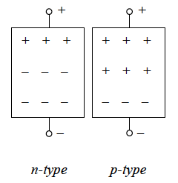
n-type Semiconductors
n in n-type stands for negative
They are semiconductors with a pentavalent (phosphorus) impurity whose conduction is due to the transfer of excess electrons.
Donor: the doping impurity atom that produces extra electrons.
In an n-type semiconductor:
The free electrons are the majority carriers
The holes are the minority carriers

Slide 16
p-type Semiconductors
p in p-type stands for positive
They are semiconductors with a trivalent (boron) impurity whose conduction is due to holes (deficit conduction).
Acceptor/recipient: the doping impurity atom that produces extra holes.
In an p-type semiconductor:
The holes are the majority carriers
The free electrons are the minority carriers

